Slide 1
Making Waves:
Developing innovative ways to study ocean waves
Notes:
Good afternoon! I am (NAME). I am in _____ grade at ____________ Middle School and I’ve been an Ocean Leader with Ocean Discovery Institute for _________ years. As future scientists, we know it’s important to share the results from science research projects, so thank you for meeting with us today! Today we will present on our research “Making Waves: Developing Innovative Ways to Studying the Movement of Waves”.

Slide 2
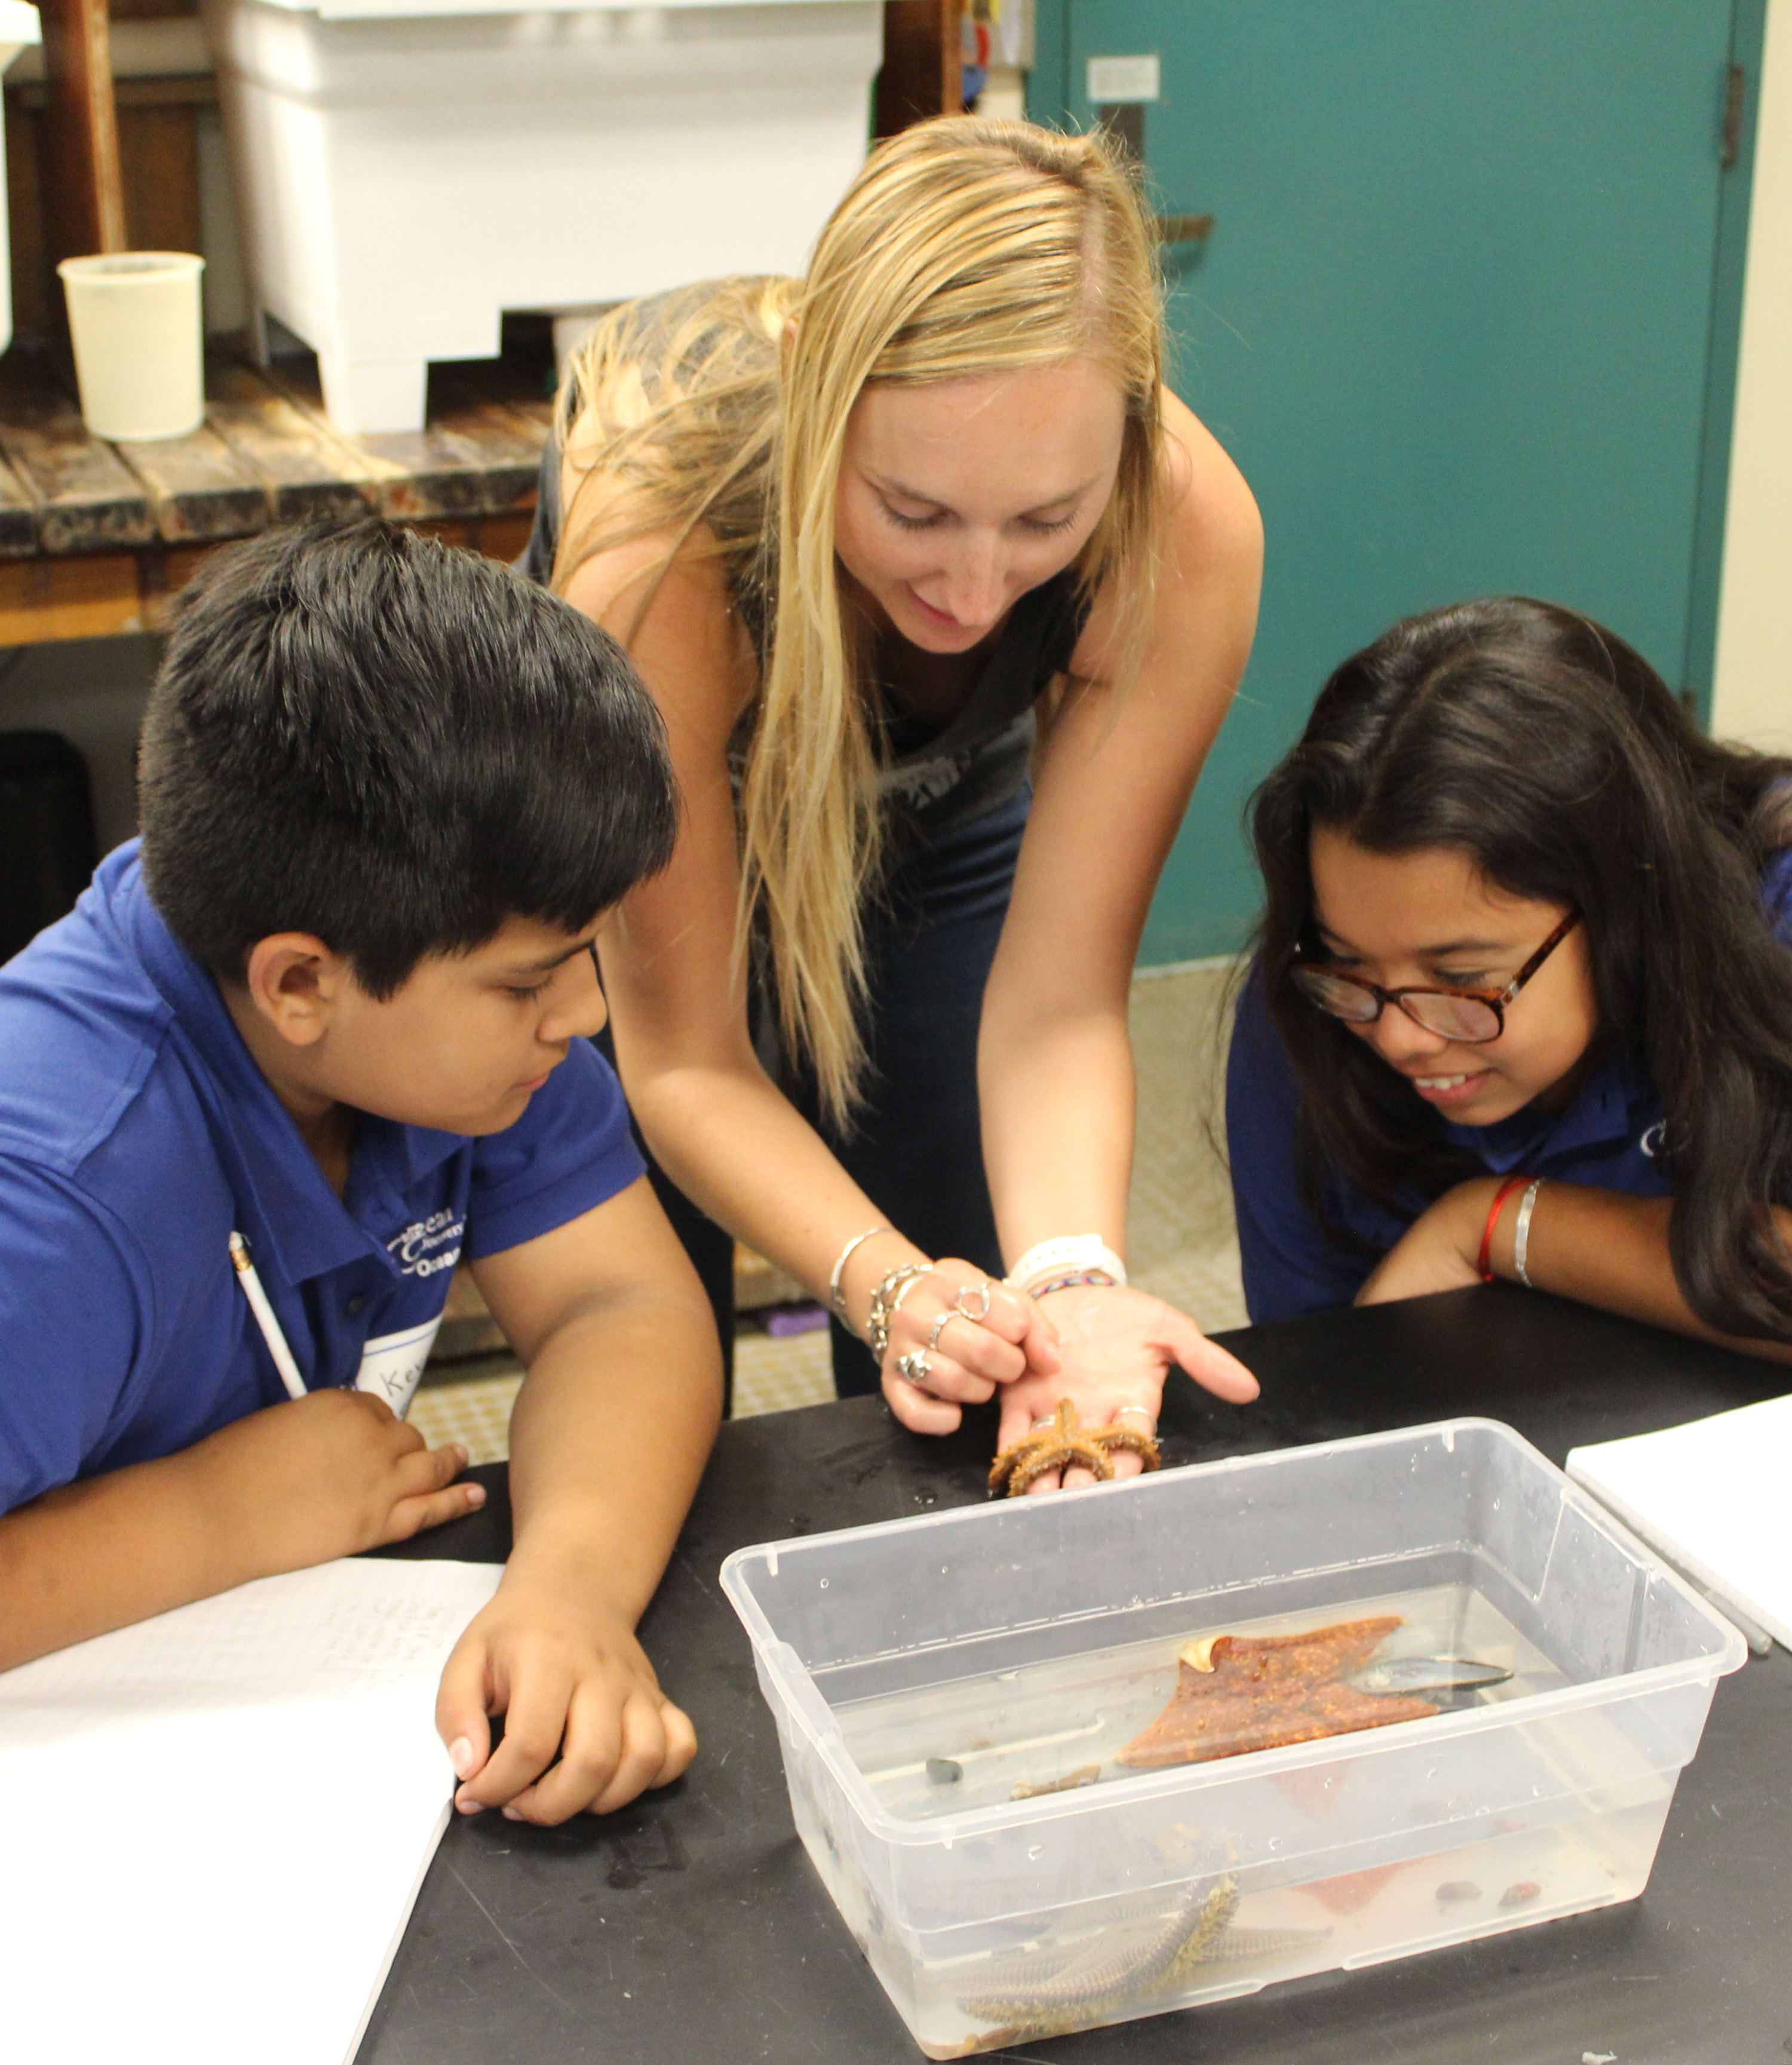

Outline
General
Partners
SES Students
Research project
Purpose
Research Questions
Methods
Results
Discussion
Student share-out
Notes:
Here’s how our talk will go today. First, we’ll highlight our science partners and our fellow students.
Then we’ll move into our research project. We’ll talk about the purpose of it, our research questions, our methods, and then discuss our results. Lastly, we’ll finish with our own reflections.

Slide 3

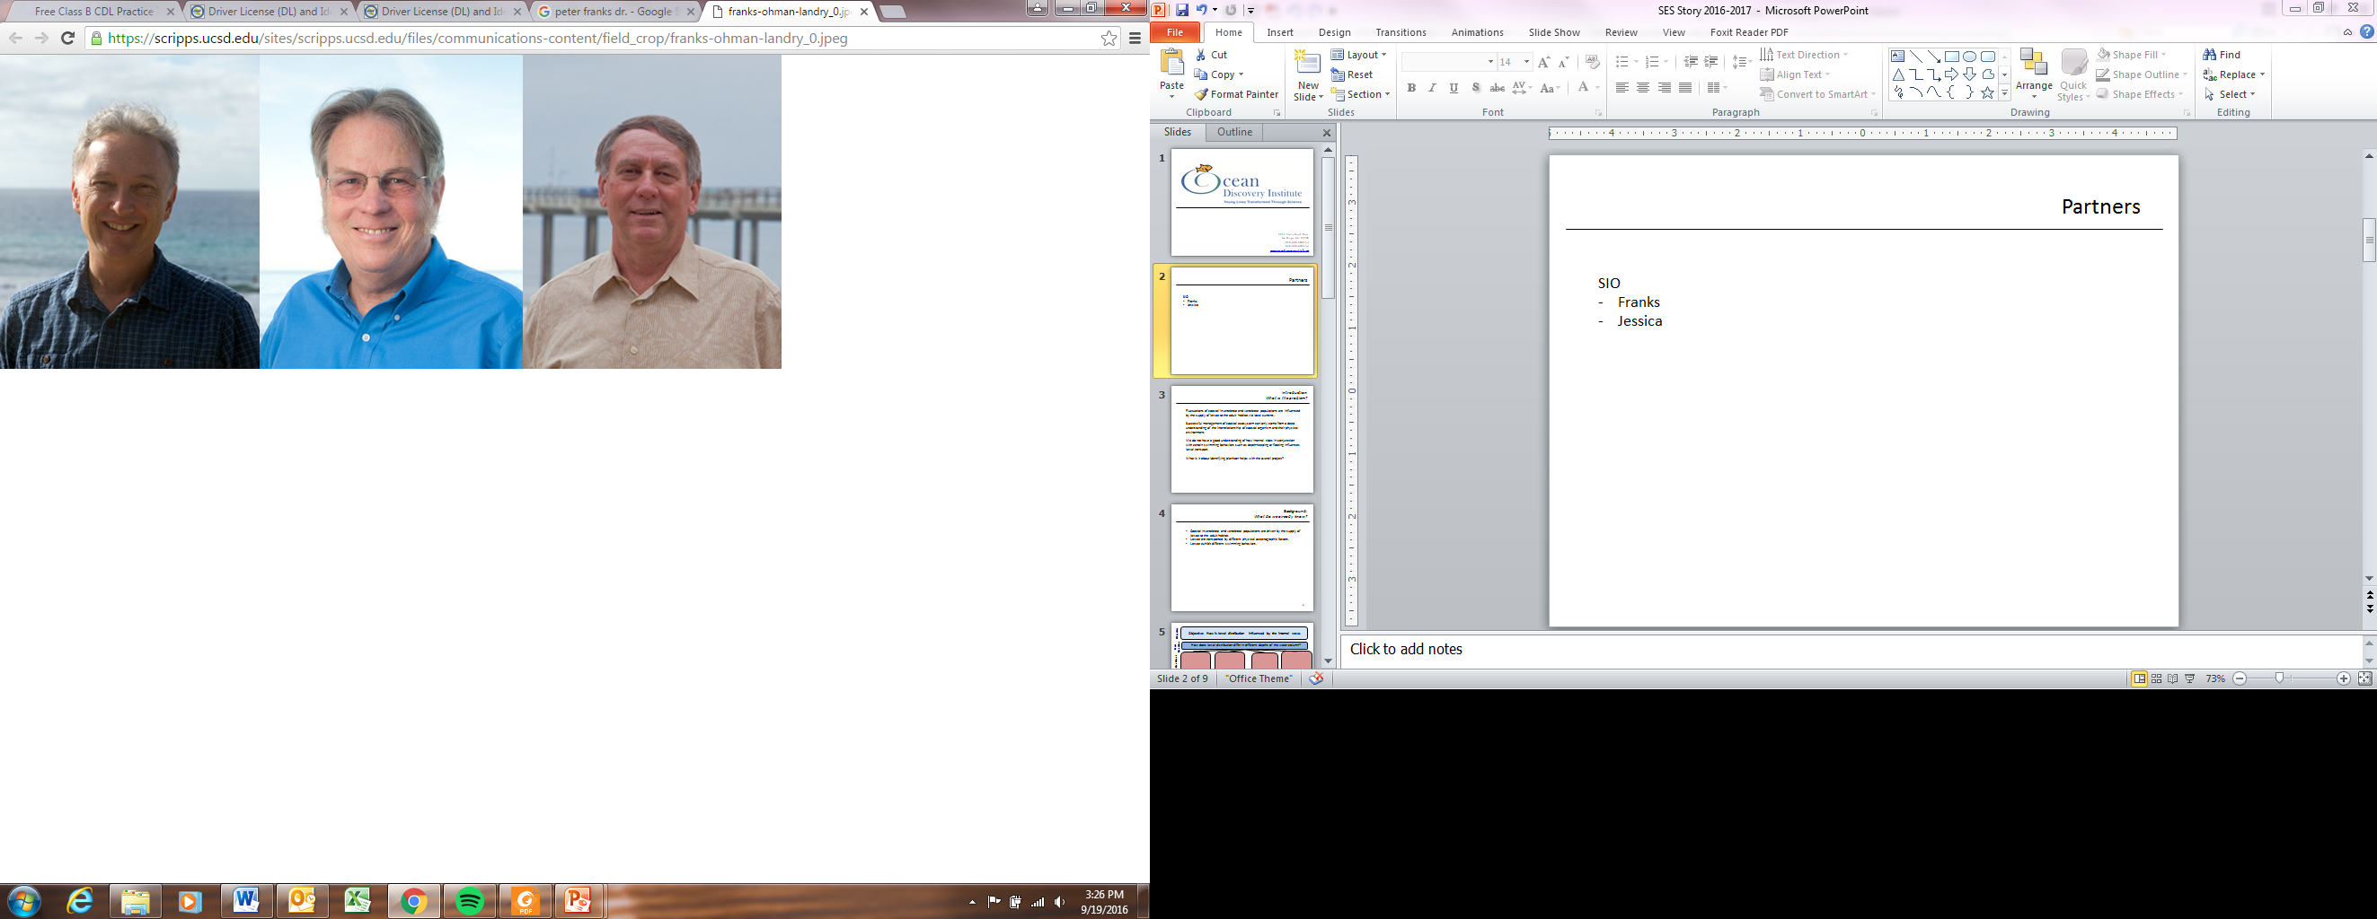
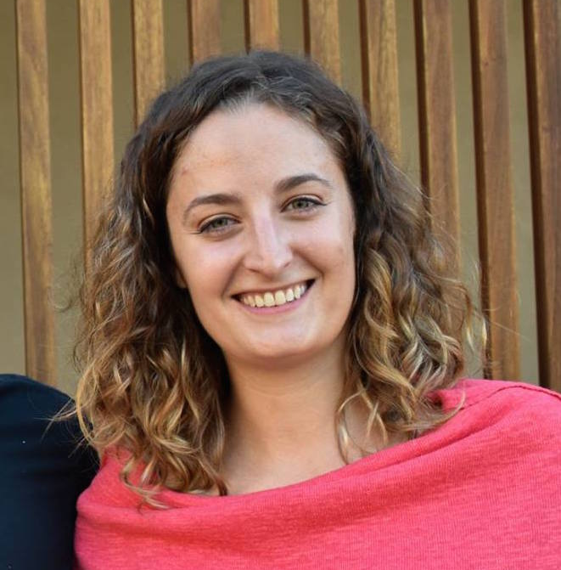
Partners
Dr. Peter Franks
Scripps Institution of Oceanography - UCSD
Jessica Carriere-Garwood
Scripps Institution of Oceanography - UCSD
PhD candidate
Notes:
Our primary partners for this work were Dr. Peter Franks and Jessica Garwood, a PhD candidate, from Scripps Institution of Oceanography.

Slide 4
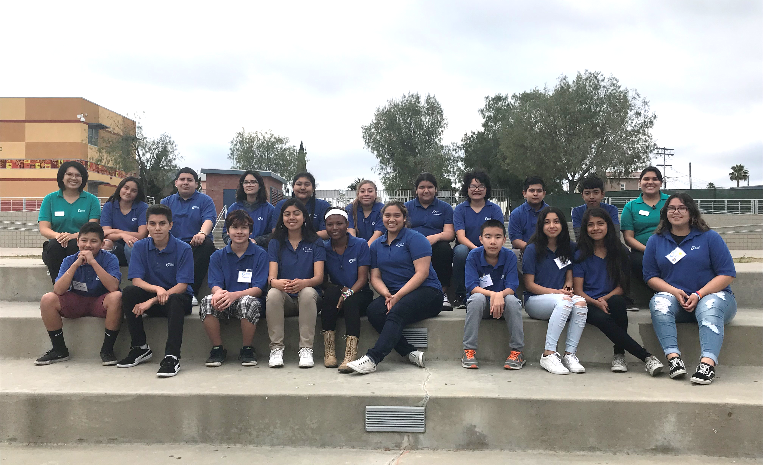
Science Empowering Students Cohort
Notes:
We completed this project with 28 student co-authors pictured here. We consist of 20 Ocean Leaders from two middle schools in City Heights, Wilson Middle School and Monroe Clark Middle School. We’re also joined by 8 high school mentors from Hoover High School who are also Ocean Leaders themselves and all of them have gone through this program before!
My name is _____________ and I am a _________ grader at (SCHOOL).
**Keep going down the line until everyone finishes introducing themselves. **

Slide 5
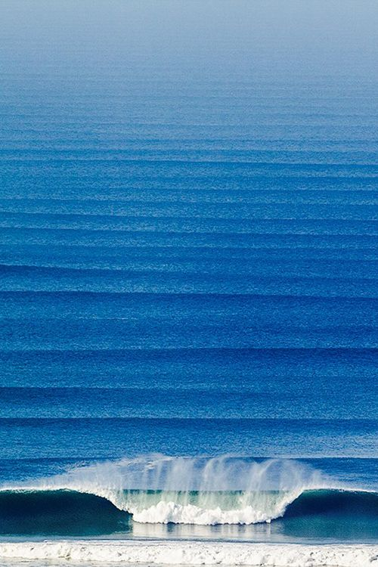
Purpose of the research How can you study ocean waves?
http://tuhinternational.com
Notes:
So what did we do for our research project this year?
We looked at WAVES! Waves are really complex, and many different groups of scientists want to learn about them for different reasons. There are also a number of ways to actually study waves.

Slide 6
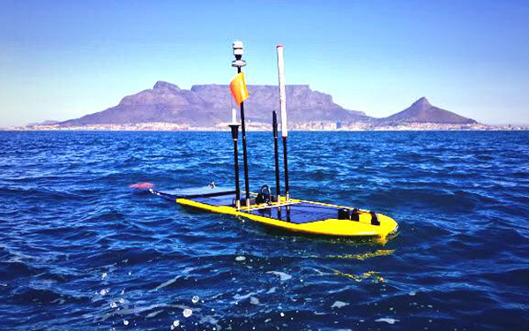
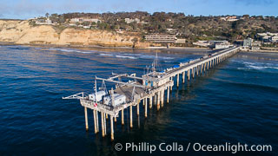
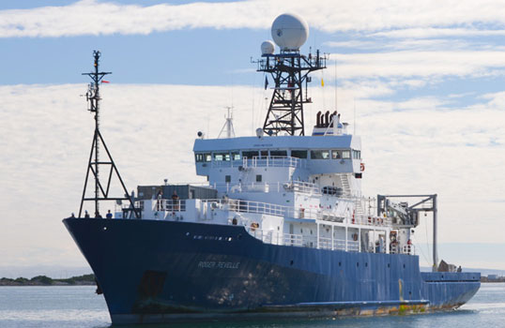
Purpose of the research How can you study ocean waves?
Sensors
SOCCO gliders
Sensors installed on Scripps Institution of Oceanography Pier
Sensors installed on robots like the Sea Glider.
Sensors installed on R/V Roger Revelle
SIO
Notes:
One way is by using sensors in the water that collect wave data.
Scientists can use sensors in many places, including on piers such as the Scripps pier, or on robots that collect data remotely, or on research ships.

Slide 7
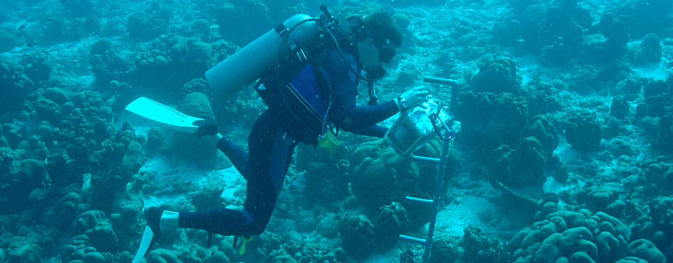
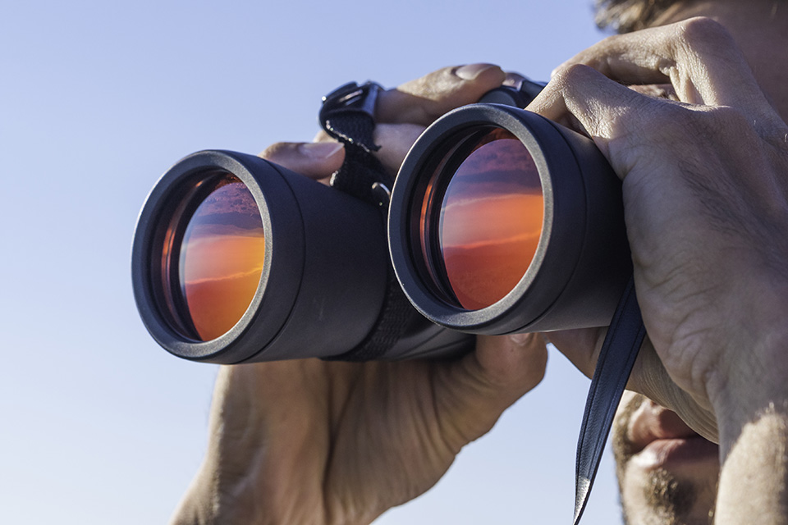
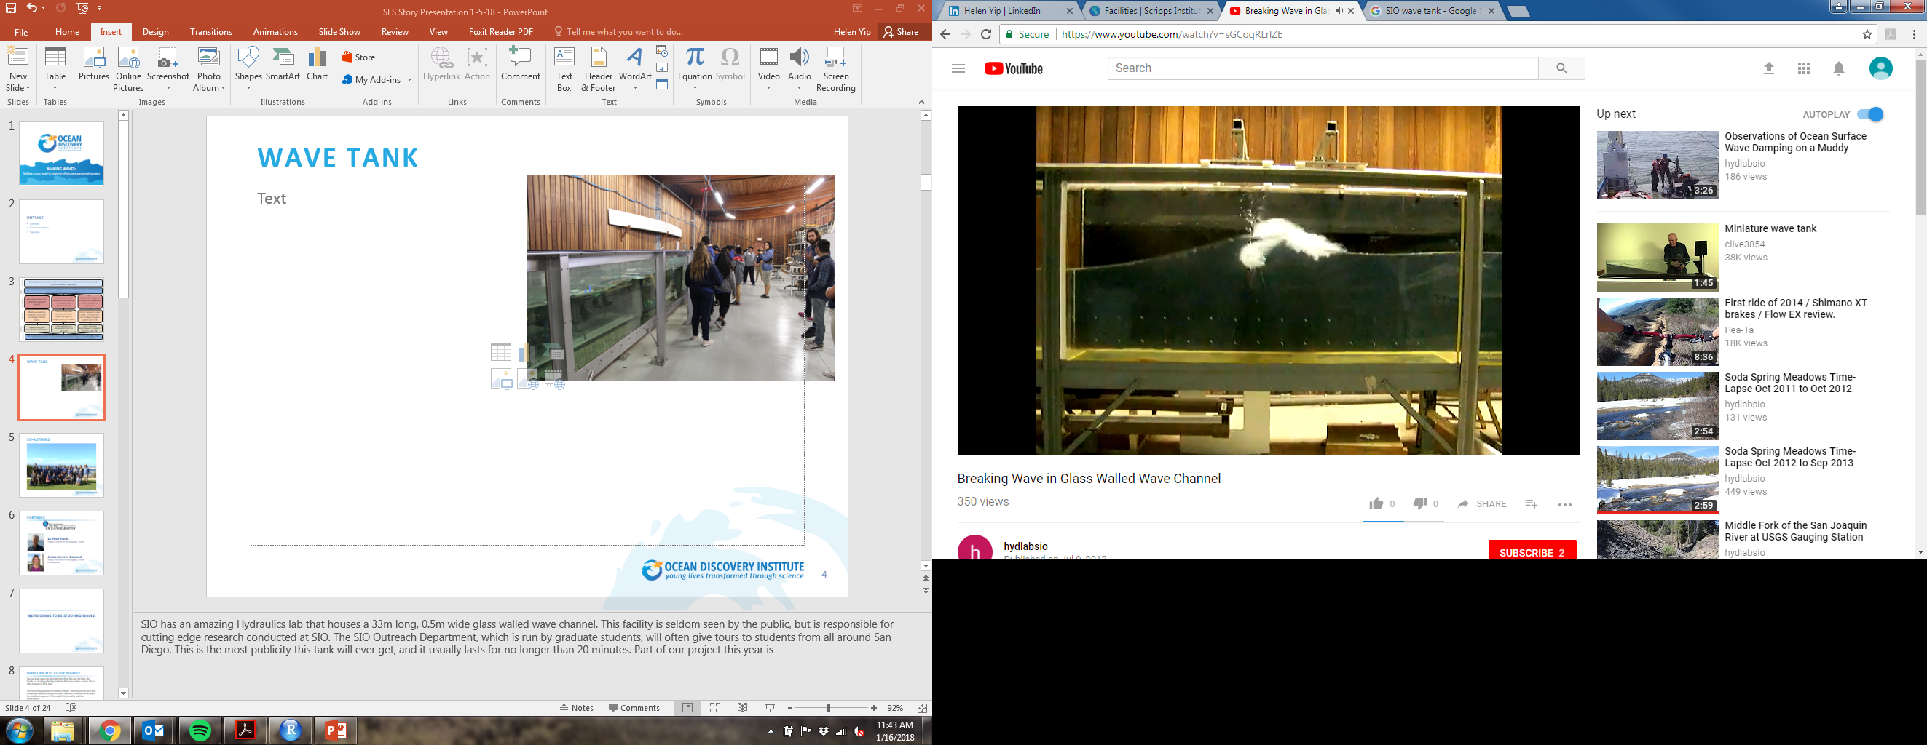
Purpose of the research How can you study ocean waves?
Observations
HiConumpstion
NOAA
Observations from land or on sea vessels.
Observations made underwater.
SIO
Observations made at a wave tank.
Notes:
Another way to study waves is through observations. They can observe waves onshore, in the water, or by models of waves as shown in this wave tank here.
I want to bring you attention to the last photo there. This is of the wave tank at Scripps, and what’s amazing is that we get to work with that this year!
I’ll show you a larger picture in just a second.

Slide 8
Who uses the wave tank?
SIO faculty and students
Tour groups
Scientists from other institutions
Notes:
This wave tank is located at Scripps Institution of Oceanography. It’s 44 meters long, 2 meters wide and 2.5 meters deep. Many different people use the tank. There are students and faculty at SIO, tour groups of students from other colleges as well as middle and high school students from around San Diego County, and even scientists from around the world use this tank!
Still, there can be barriers for people who wish to use the tank. Visitors can only use it when a trained operator is there. It’s also only useful for people who can visit it in person. So, how can more people experience the usefulness of the wave tank?
That is the issue we addressed this year. We want to provide a package that can be accessed off site so people can get the wave tank experience without actually being at the wave tank!

Slide 9

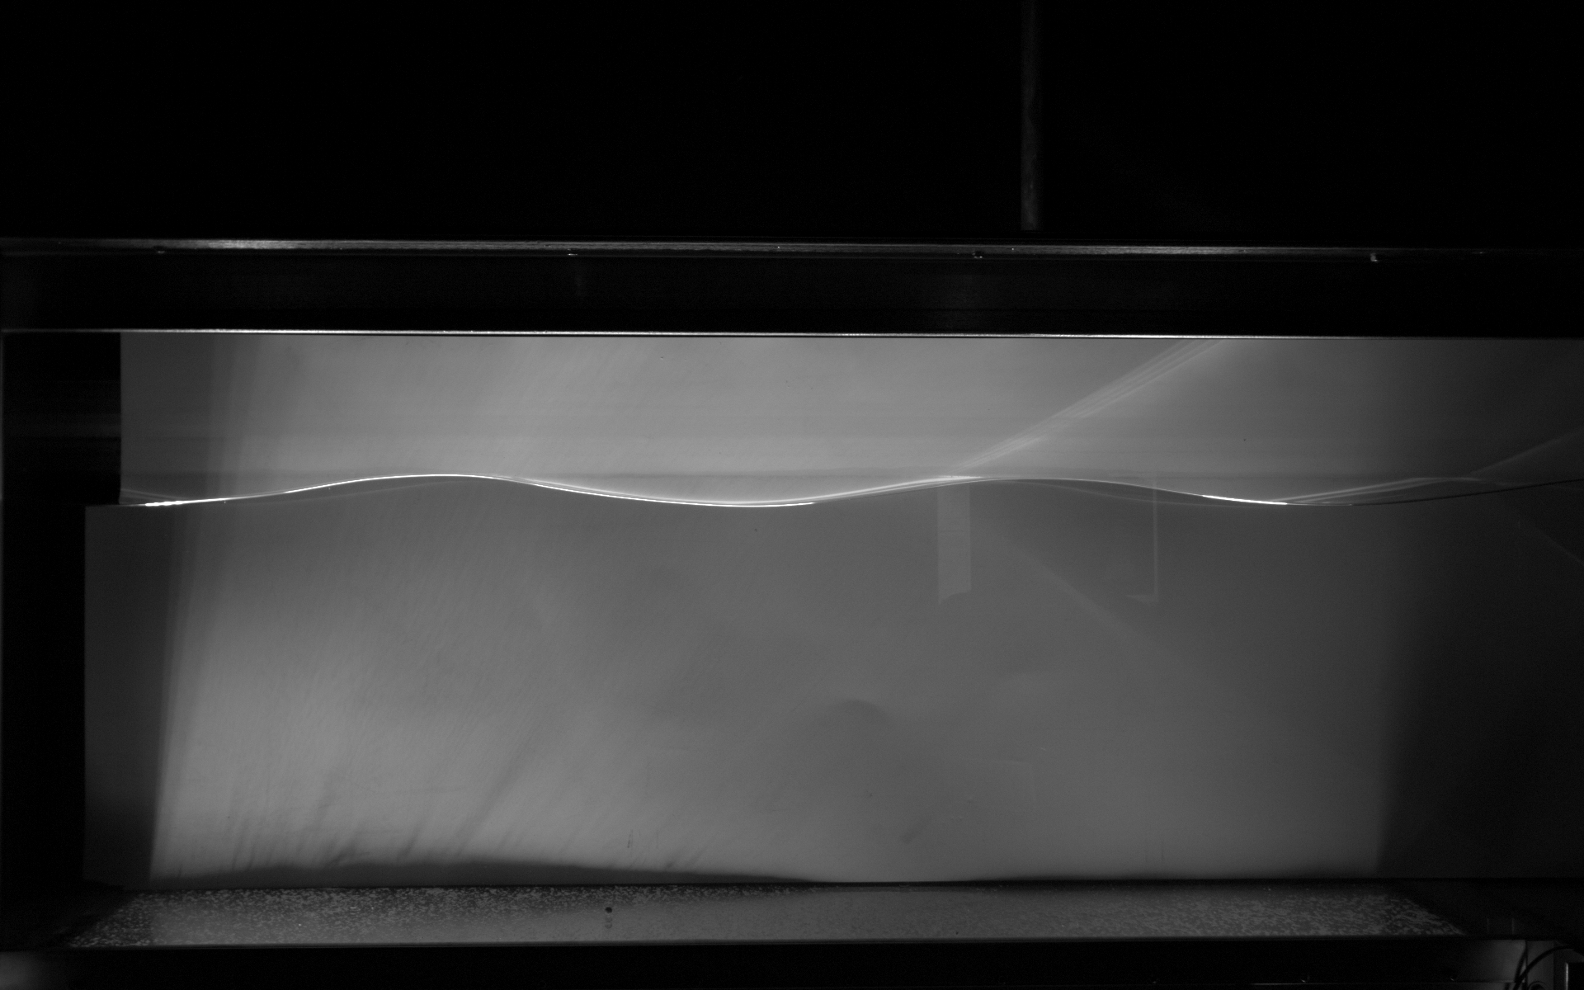
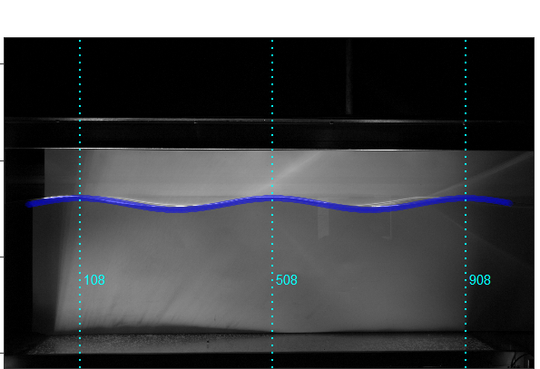
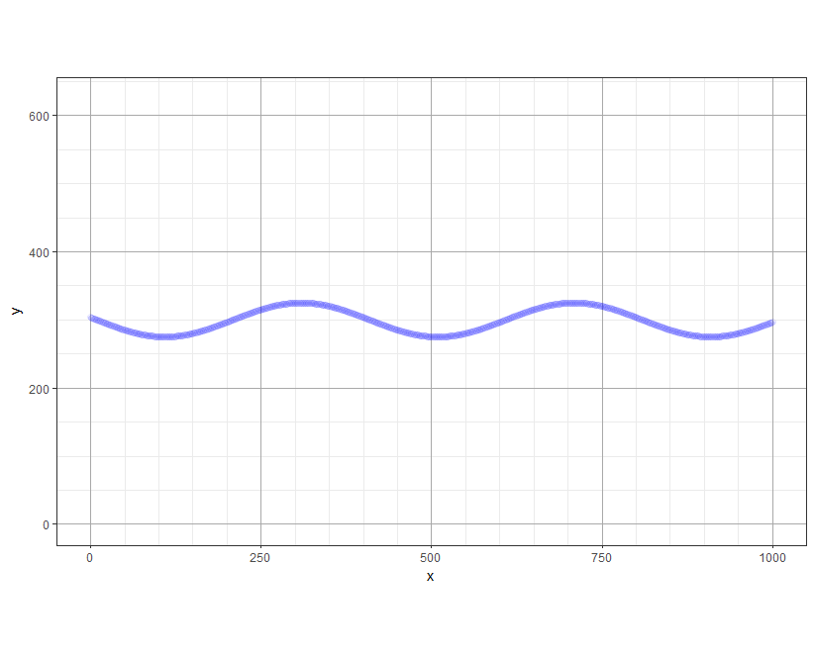
What did we do?
1. Learn how to code.
2. Generated waves at the wave tank.
3. Extracted data from waves.
4. Tested model against wave tank images.
Notes:
So what did we do? This slide shows the four main parts of our project, and we’ll explain each in more detail later.
First we learned how to code using a coding platform called R! We learned to do things like move objects across a grid, create shapes with different colors, and we even created our own maze!
Second, we generated different kinds of waves at the wave tank.
Third, we analyzed the waves and extracted data from the images.
Lastly, we tested our model against the wave tank images.
Now we’ll explain these steps in a little more detail.

Slide 10
Research Questions
How do wave tank experiments and theoretical models allow us to make predictions about waves in the ocean?
Notes:
We’ll start the research question that was guiding our project: How do wave tank experiments and theoretical models allow us to make predictions about waves in the ocean?
We chose to approach this question in two parts.

Slide 11
Research Questions
How do wave tank experiments and theoretical models allow us to make predictions about waves in the ocean?
1. How is wave speed related to wave properties in wave tank simulations?
2. How well do our theoretical predictions of a wave compare with waves generated in the tank?
Notes:
Our first question was “How is wave speed related to wave properties in wave tank simulations?”
We addressed this question first, and then used the results to inform our second question, which was “How well do our theoretical predictions of a wave compare with waves generated in the tank?”
Next, we’ll explain our methods and results for these questions one at a time.

Slide 12
How is wave speed related to wave properties in wave tank simulations?
METHODS: Question 1
1. Obtain images from wave tank.
Notes:
In order to determine how wave speed is related to wave properties in wave tank simulations, first, we obtained images of waves we generated at the wave tank.

Slide 13
How is wave speed related to wave properties in wave tank simulations?
METHODS: Question 1
2. Calculate wavelength, amplitude and water depth from measurements.
Crest 1
Crest 2
Wavelength (λ)
Amplitude (m)
Water depth (m)
13
Notes:
Second, we calculated 3 properties of the wave in the image: wavelength, amplitude, and water depth.
To do this, we first aligned rulers on the image to get either the x-position or y-position of certain properties.
Then, to better understand these properties, we calculated them by hand. Once we were familiar, we used the R coding platform to complete this step automatically, which is much faster!

Slide 14
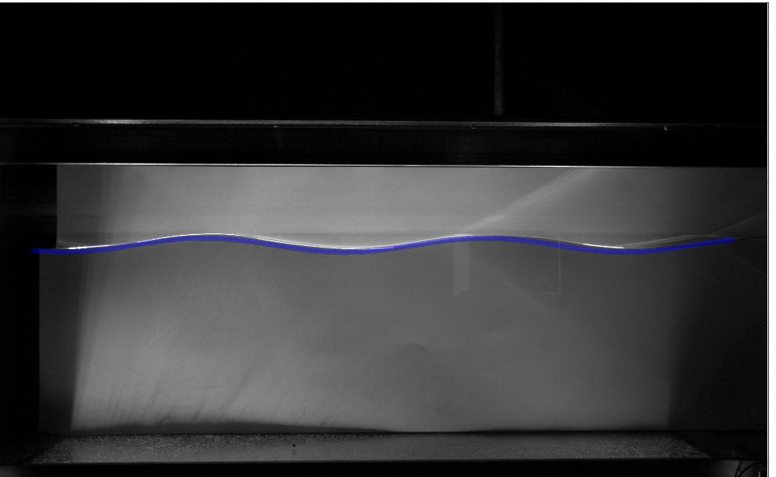
How is wave speed related to wave properties in wave tank simulations?
METHODS: Question 1
3. Generate model wave that overlays wave tank image.
Notes:
Next, we used R to create our theoretical wave model from all those measurements. Do you see the purple line in the shape of a wave? That purple line is the theoretical model we created from extracting data from the original image.

Slide 15
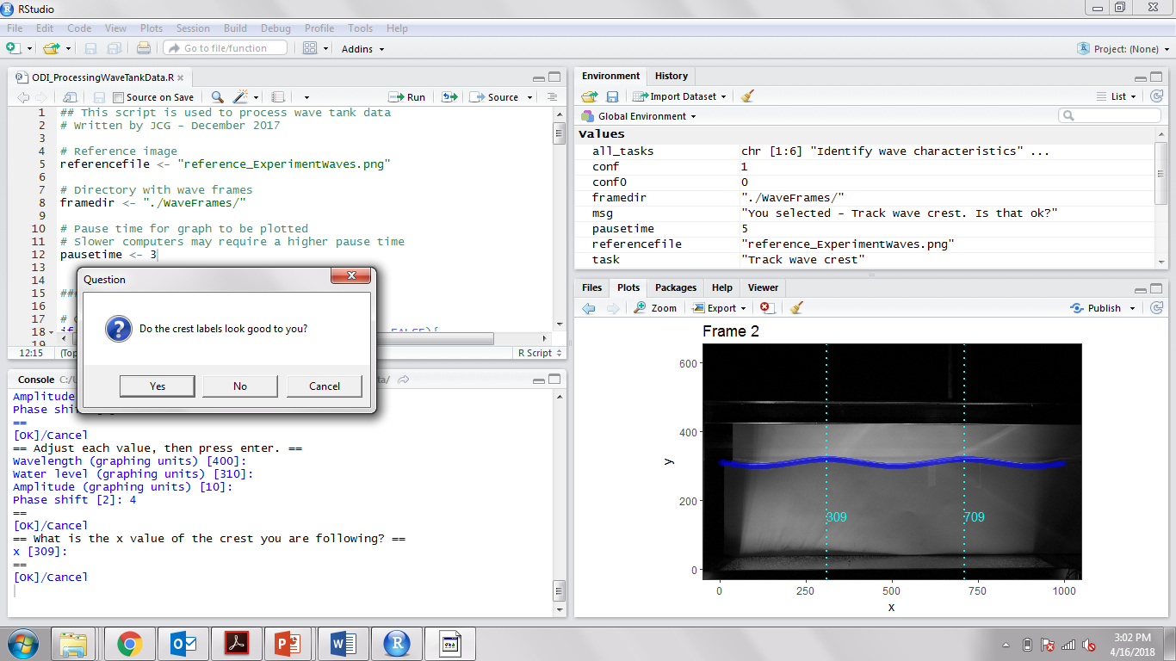
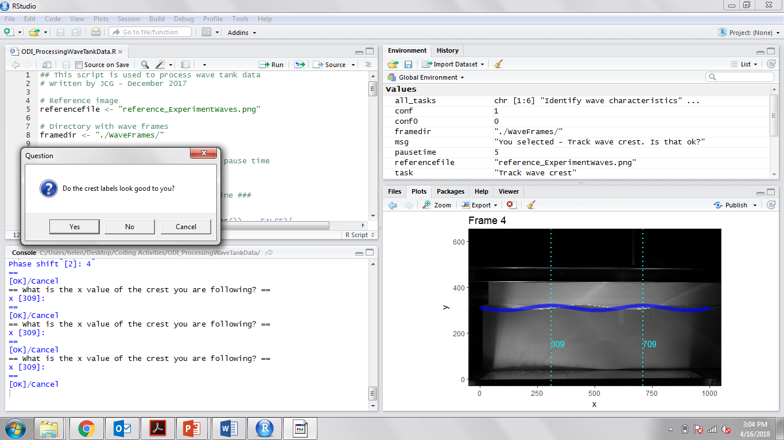
How is wave speed related to wave properties in wave tank simulations?
METHODS: Question 1
4. Track wave crests between wave image.
Image 1
0.1 sec
Image 2
Notes:
Remember, we did all this in order to calculate wave speed.
So, in our final step, we analyzed a set of five images taken from the wave tank, taken very quickly – only 0.1 seconds apart. We tracked the wave crests between images – the blue arrows show how the crest has moved from image 1 to image 2. This allowed us to calculate wave speed.
We matched our theoretical model – again, shown here as the purple line – to each image, which allowed us to track the distance traveled by one wave crest.

Slide 16
Results: Question 1 How is wave speed related to wave properties in wave tank simulations?
Notes:
Now we can look at the results for our first question, which was how wave speed is related to wave properties in the wave tank.
This graph shows the data we collected of how wave length is related to wave speed. The x axis shows wavelength, and the y axis shows wave speed. The blue dots are each individual waves.
The trend you can see here is that as wavelength increases, wave speed also increases.
We used this information to help answer our second research question.

Slide 17
Research Questions
How do wave tank experiments and theoretical models allow us to make predictions about waves in the ocean?
1. How is wave speed related to wave properties in wave tank simulations?
2. How well do our theoretical predictions of a wave compare with waves generated in the tank?
Notes:
We’ve just explained how we answered the first question.
Now, we’ll address our second question, which was how well do our theoretical predictions of a wave compare with waves generated in the tank?

Slide 18
Results: Question 2 How well do our theoretical predictions of a wave compare with waves generated in the tank?
Notes:
Here is how we made that comparison between the observations from wave tank to our theoretical wave model.
Before I explain the graph, it’s important to know how we determined the theoretical wave speed for our model to use in our comparison. Our partner scientist, Jessica, determined the correct equation to use based on the properties of the waves from the wave tank.
Then we compared our theoretical wave speed (represented by the black line) to our observed wave speeds. And as you can see, the fit looks relatively good. It shows that as you increase wavelength, wave speed increases. Some of our points sit right on top of the line, while others don’t.
Next, we’ll explain some theories of why some of the observed waves don’t match the model.

Slide 19
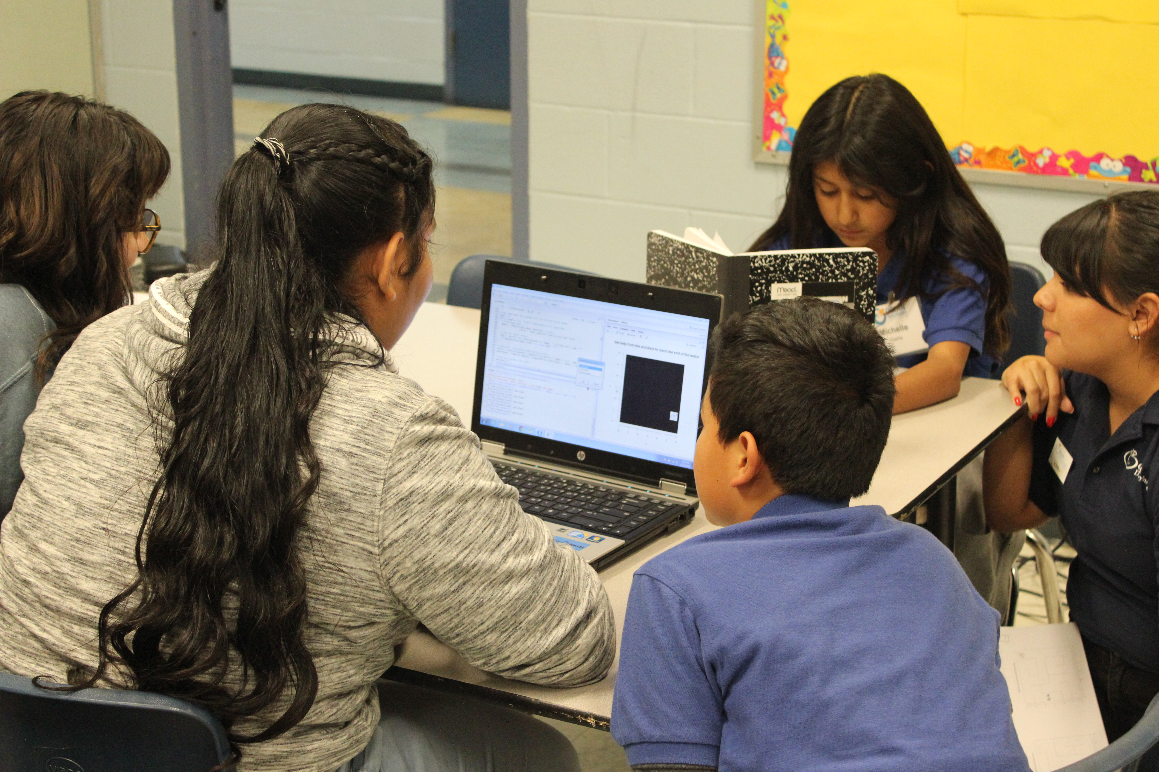
Discussion
Ways we can improve accuracy:
More time for analyzing waves
Increase the number and types of waves analyzed
More consistency between groups
Students completing coding activities.
Notes:
First, the coding software was complicated to learn. We became familiar with it over time, but we’re sure we’d become more comfortable using R with even more time to practice.
Second, we had only 16 observed waves in our dataset. We think that increasing the number and types of waves would improve our understanding of the model’s accuracy.
Third, we conducted this project in groups and some groups may have taken different approaches to analyzing the waves. We think having more consistency between groups would also improve our understanding.

Slide 20
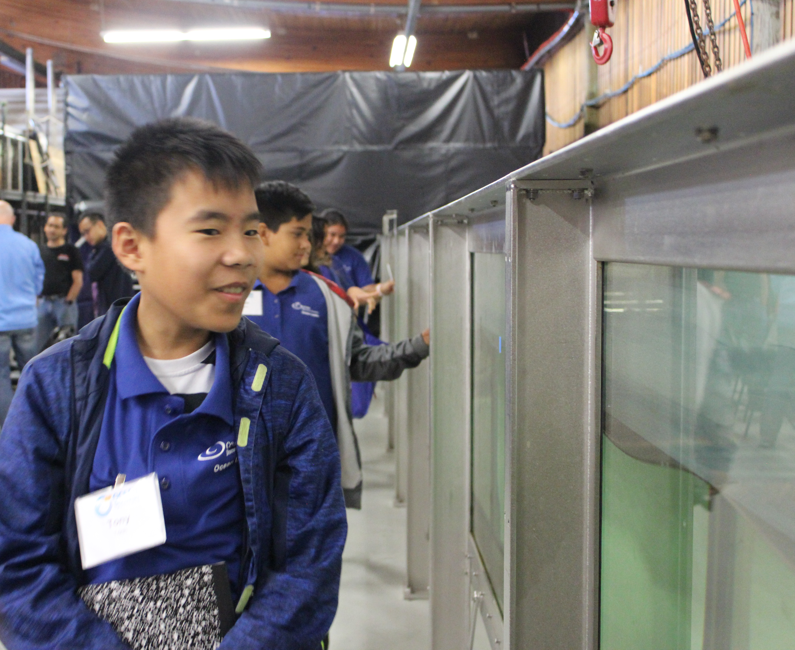
Summary
This research:
Provided a data analysis tool for visitors who interact with the wave tank at SIO.
Tested a program for other students who want to learn how to code while learning about ocean waves and their properties.
Showed us how oceanographers collect data and study the ocean in the lab.
Students visiting the wave tank.
Notes:
We’ll close with a summary of our main takeaways.
First, you’ll remember that we wanted to create a tool for people to access the wave tank’s usefulness when they are offsite.
From our efforts to create a theoretical wave model, we have now produced a tool that can simulate the wave tank experience.
Second, the project we conducted can be replicated with other students groups who are interested in building coding skills while learning about the ocean.
Lastly, this experience helped us understand the different ways that oceanographers can study waves.

Slide 21
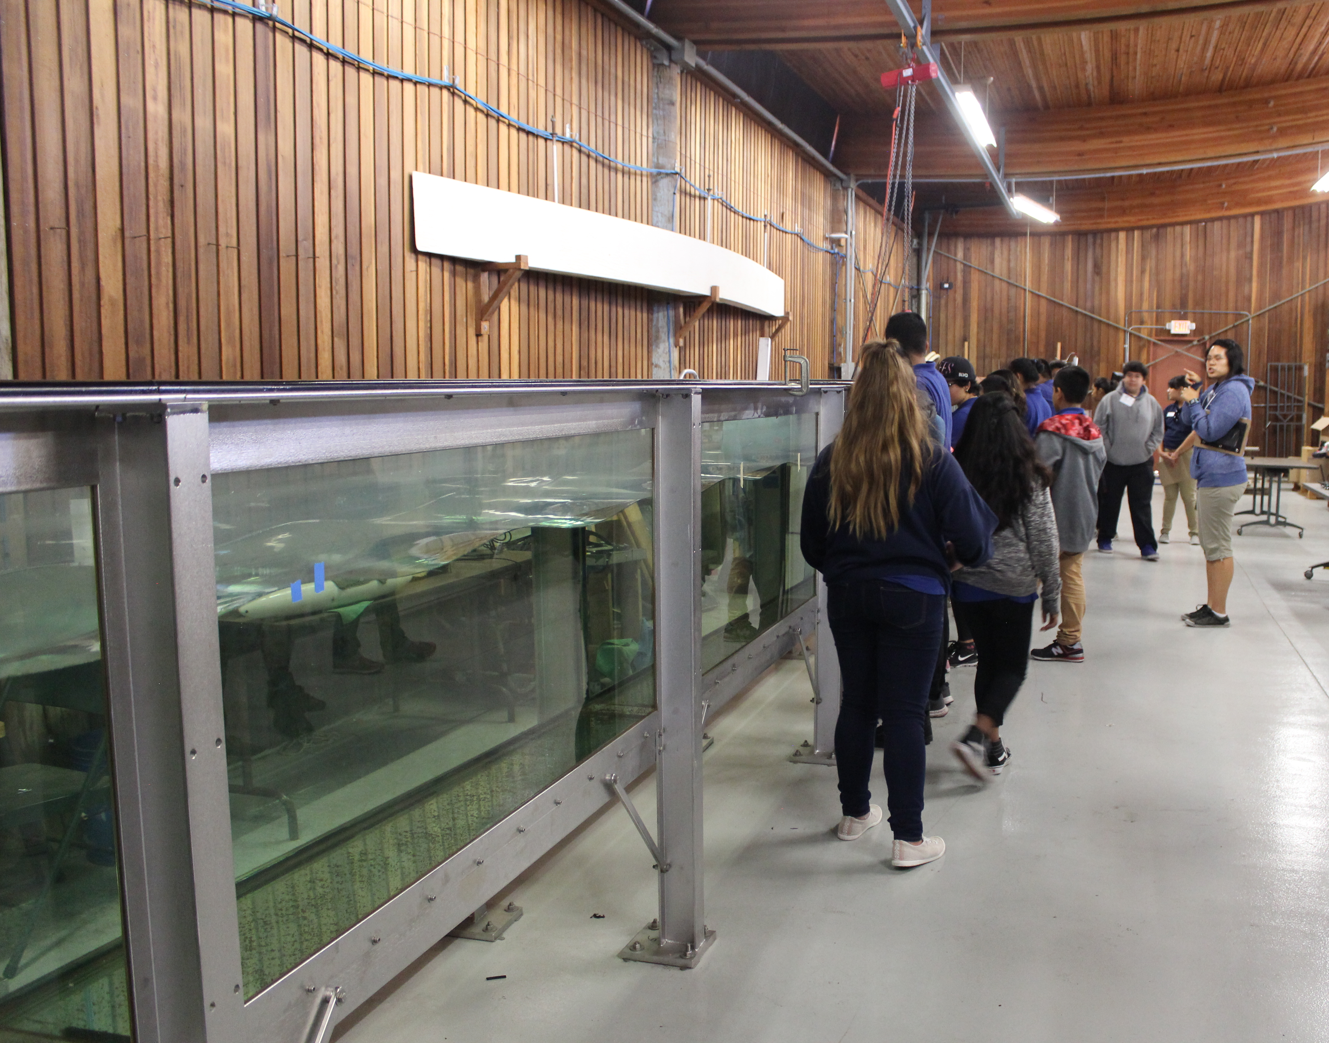
Next steps
Create an automated wave model – it moves on its own
We can use this automated wave model to answer simple wave questions without the tank
Students visiting the wave tank.
Notes:
What could happen next?
The theoretical wave we created in this project doesn’t move on its own. One interesting next step would be to create an automated wave that moves on its own using the R coding software.
We could then use that automated wave model to answer simple wave questions without accessing the tank, like how do waves affect the movement of particles, such as plankton, in the water column?

Slide 22
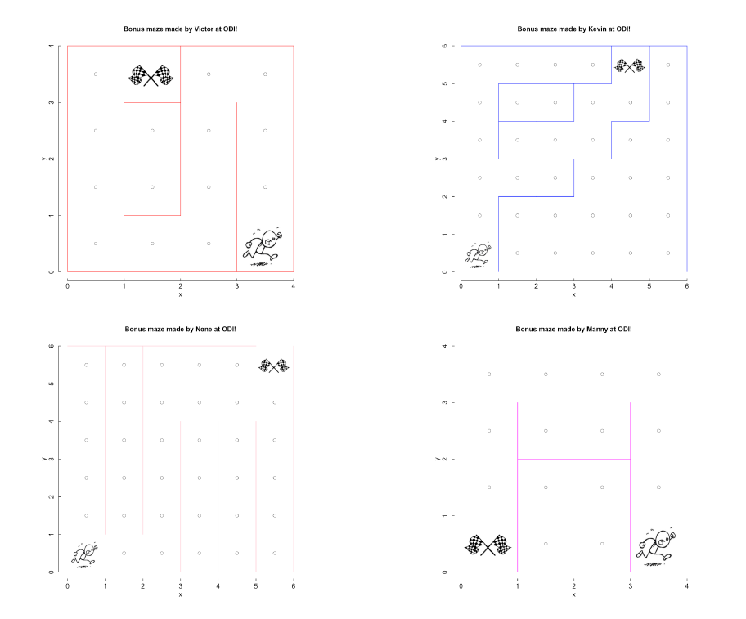
A-maze-ing work!
Notes:
Lastly, we want to take the time to reflect on our experience in the program this year and what our favorite moments were.
To begin, here are a few of our mazes that we created in the fall when we were learning how to code! We created barriers to make it harder for the user to get the running man to the finish flags. We played this in groups of two. There was one person who played the architect and had to describe to the player the layout of the map, which was all blacked out. Then the player has to decide in what direction the running man moves. If the player incorrectly inputs the move and the running man hits a wall, game over! But if they make it to the flags without touching any walls, they win!

Slide 23
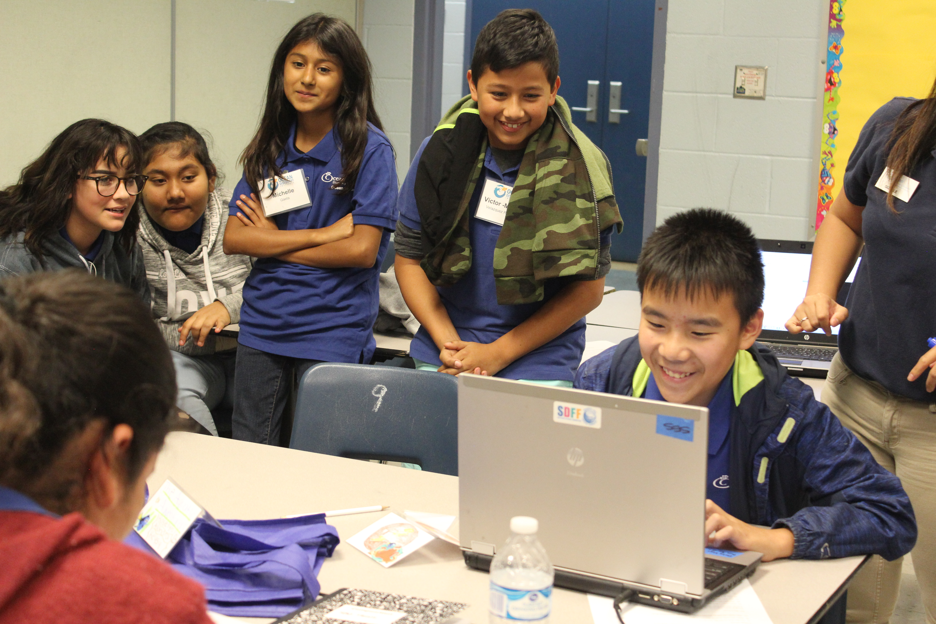
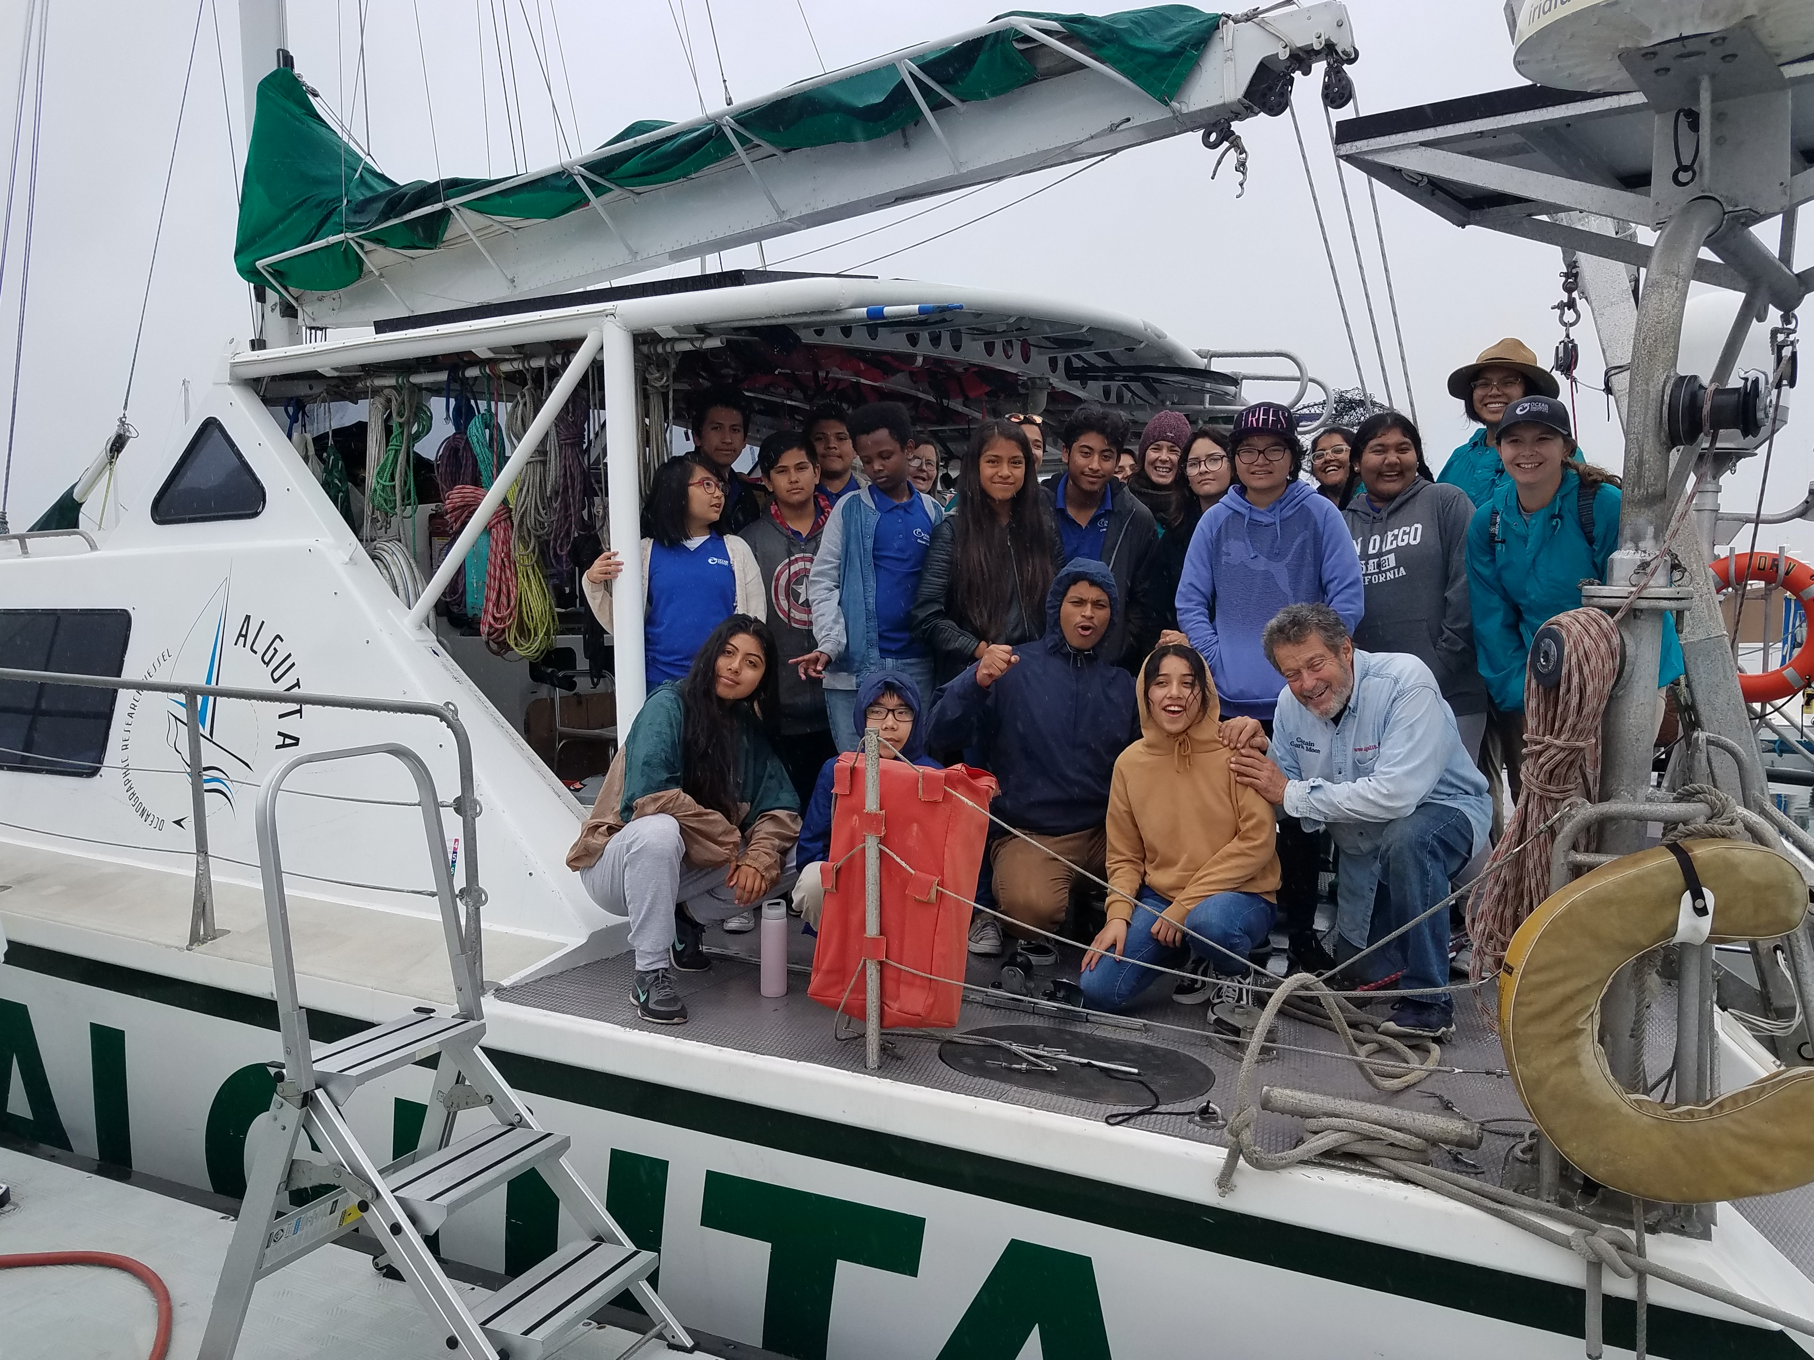
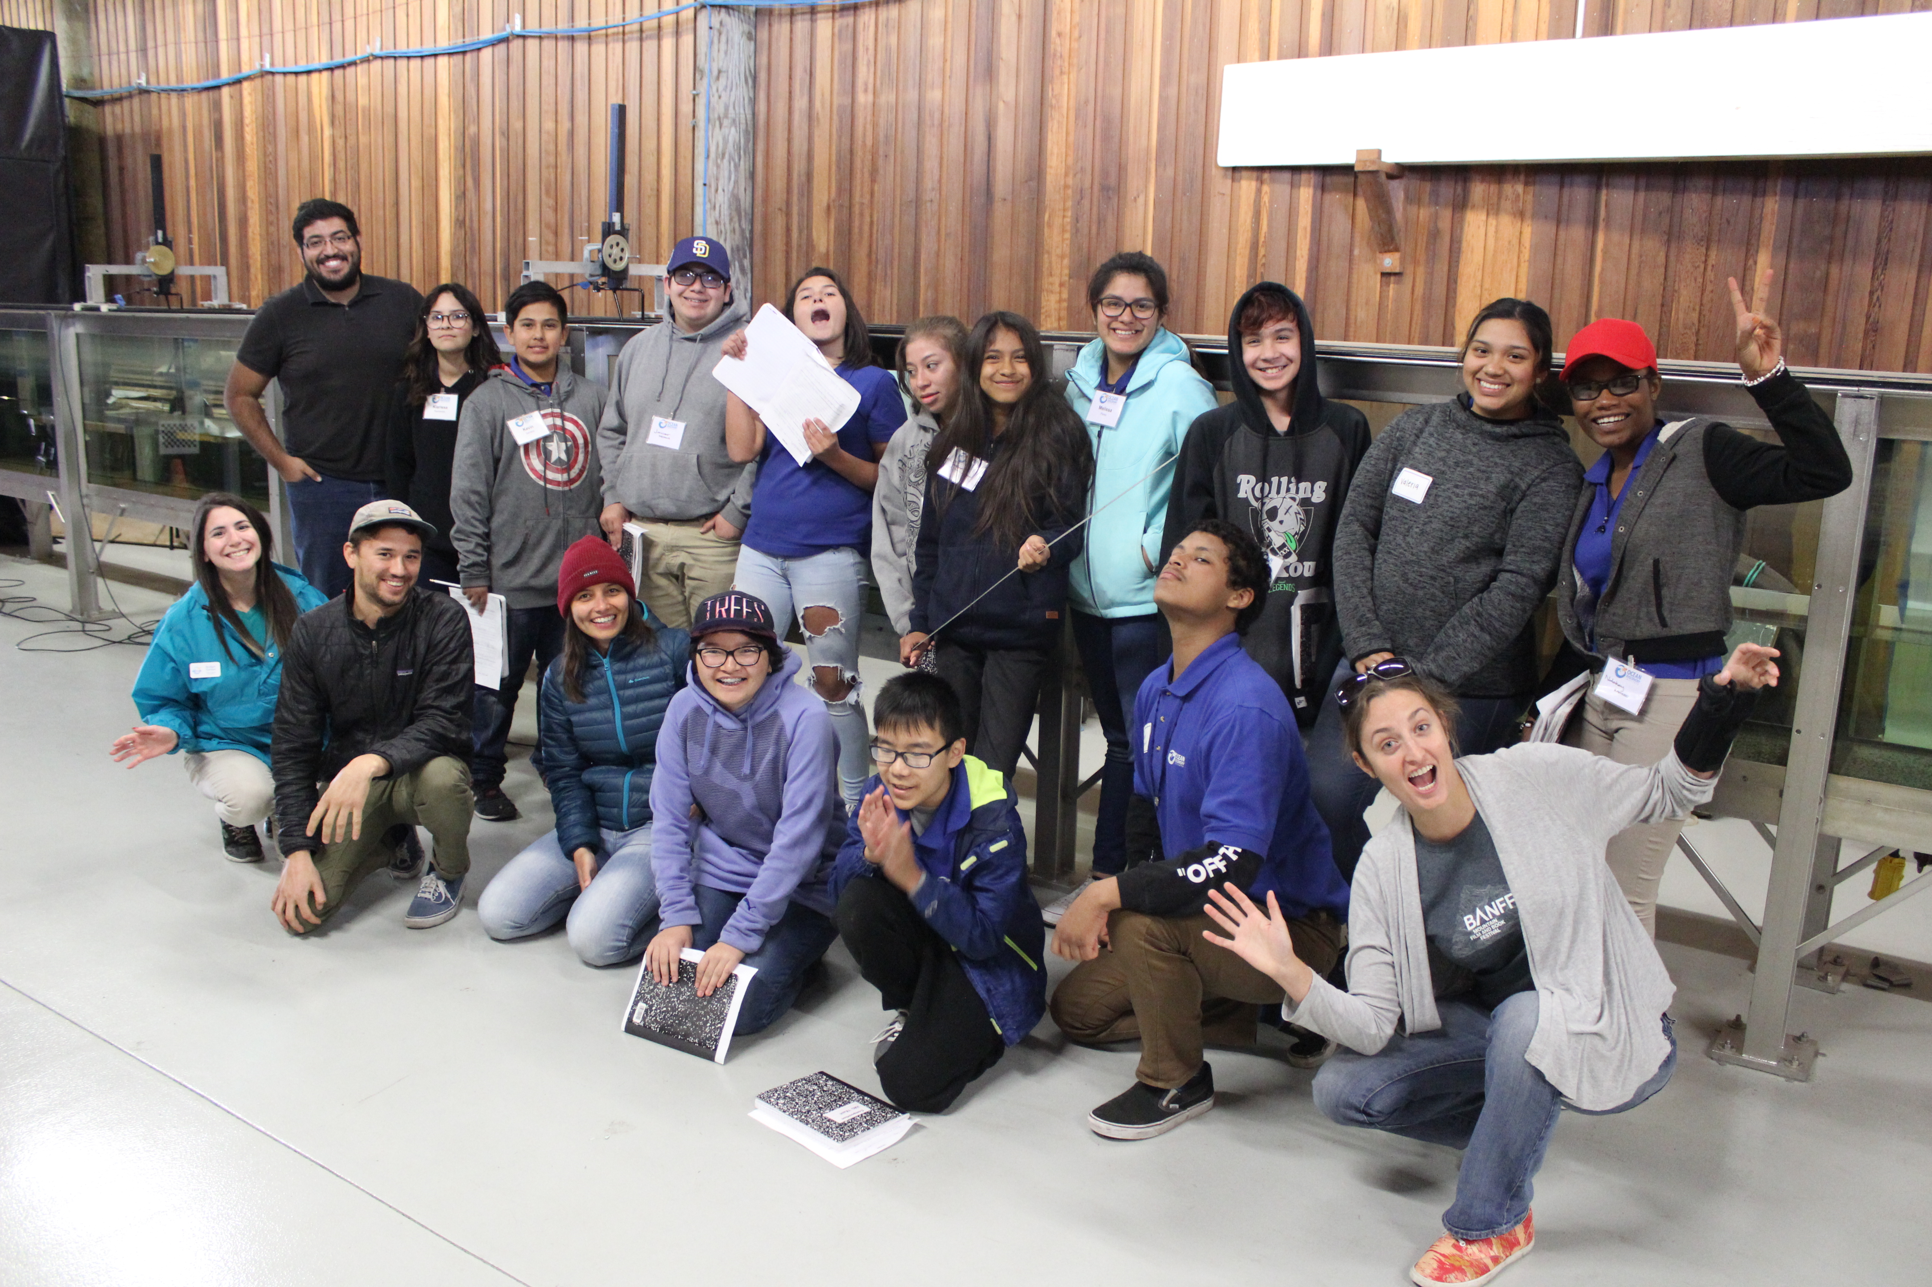
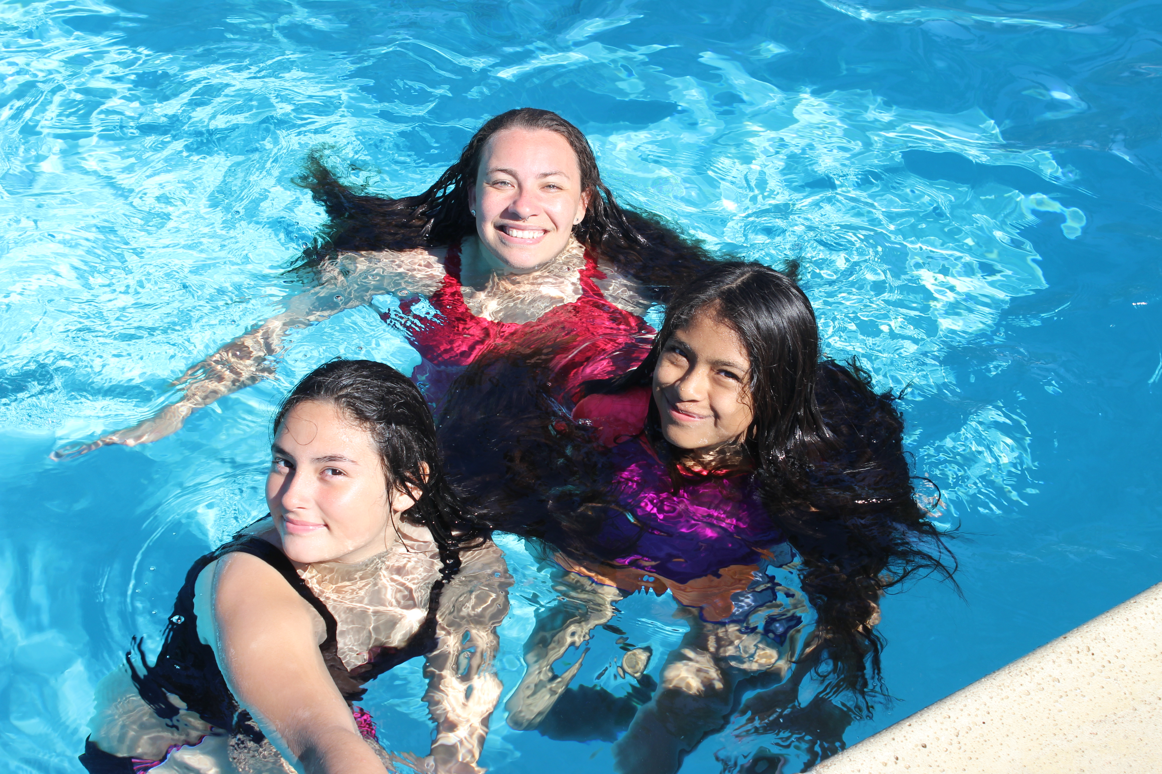
My favorite moment was…
Notes:
Lastly, we wanted to conclude with our favorite moments.
*Go down the line with the following prompts until finished*
My favorite moment during the science project was…..
My favorite moment during the whole program was….

Slide 24
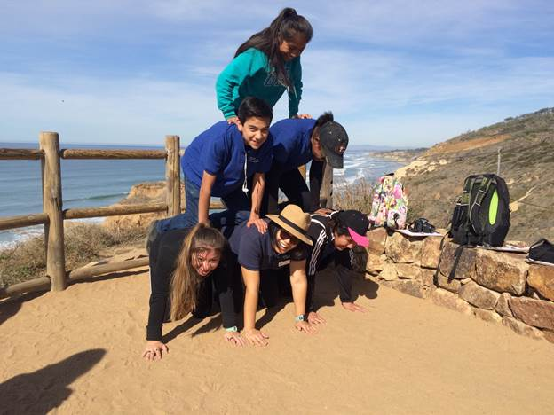
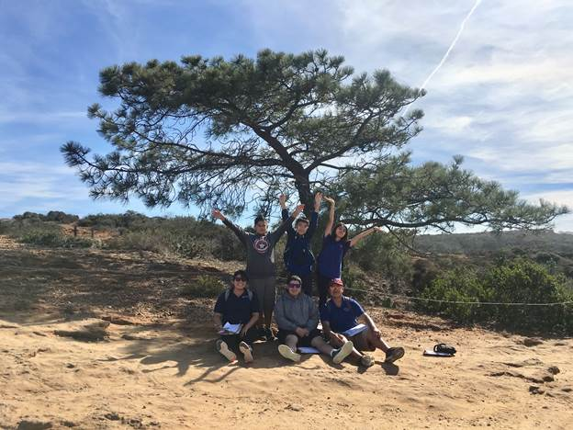
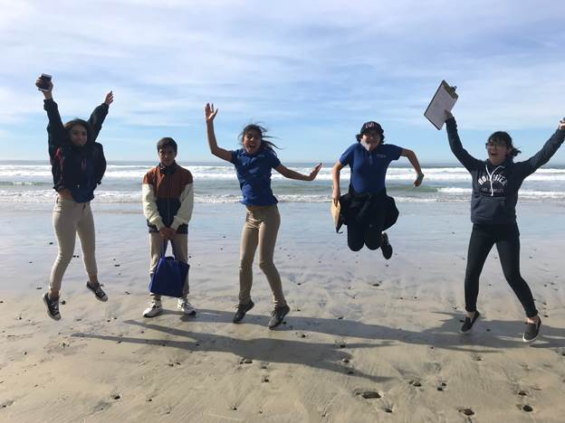
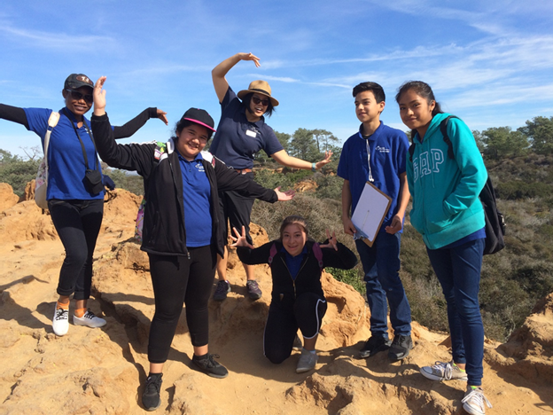
Questions?
Notes:
Any questions?

